Slide 1
.CODE MOUNTAINEERS
NAME | BATCH | ROLL NO
YAHYA KHAN | BATCH-15 | 345928
SAAD MUTTAHIR | BATCH-15 | 344062
M.JUNAID | BATCH-15
A.ARIF | BATCH-15

Slide 2
COURSE | WEB AND MOBILE APP DEVELOPMENT
ASSIGNMENT | HIMALAYAN SHILAJEET WEBSITE DESIGNING
TRAINER | SIR MUHAMMAD SAAD
START DATE | 26-12-2024
END DATE | 29-12-2024

Slide 3
Himalayan Shilajeet Website Documentation:
Introduction:
This document provides an overview and detailed explanation of the Himalayan Shilajeet website structure, elements, and functionalities. The website is designed to promote and sell Shilajeet products, highlighting their benefits and uses.

Slide 4
Table of Contents:
1. Overview
2. File Structure
3. Website Sections
4. CSS Styling
5. Media Elements
6. Footer

Slide 5
1. Overview:
The website is built using HTML, CSS and Media query. It includes:
A navigation bar for seamless navigation.
A video section showcasing promotional content.
Informative sections about the benefits of Shilajeet.
Product display and description cards.
A footer with contact and additional information.

Slide 6
HTML File: index.html
CSS File: shilajeet.css
Assets:
Images: Located in ./images/
Videos: Located in ./videos/
Icons: Located in ./images/icon/
2. File Structure:

Slide 7
a. Navigation Bar
Purpose: To provide easy access to different sections of the website.
Components:
Logo
Menu items: Home, About, Product, Benefit, Contact
Sign-Up Button linking to form.html.
Styling:
Background color: RGB(78, 78, 78)
Text color: White
Button hover effect with color transition to green.
3. Website Sections:

Slide 8

b. Video Section:
Purpose: To engage users with a promotional video.
Elements:
Video file: video.mp4 with controls for play/pause.
c. Icon Marquee:
Purpose: To display icons in a scrolling marquee effect.
Styling:
Background color: Black
Icon size: 60px height with spacing.

Slide 9
d. Header
Content:
Title: "Pure Himalayan Shilajeet - in Pakistan"
Description about the product's origin, benefits, and uses.
e. Information and Benefits Section
Purpose: To highlight the advantages of using Shilajeet.
Components:
Two columns: Informative boxes with images and descriptions, and a central image of Shilajeet.

Slide 10
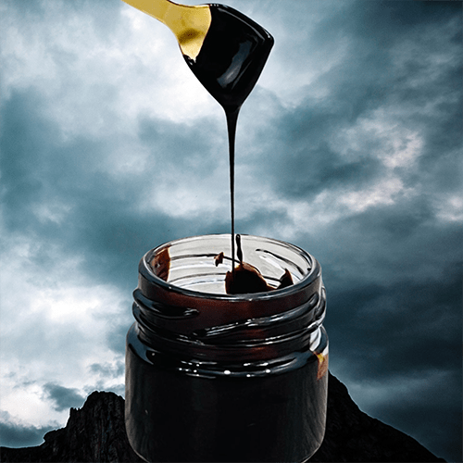
f. Product Card Section
Purpose: To showcase Shilajeet products.
Components:
Product cards with images and titles: Resin, Capsules, Powder, Tea.
Styling: Hover effect with scaling.

Slide 11
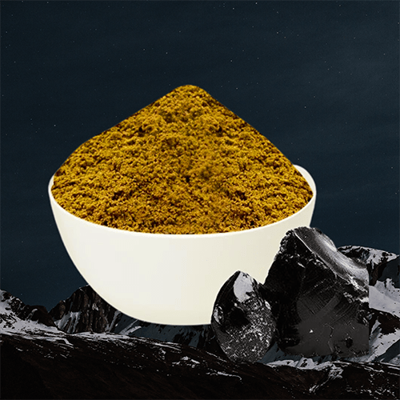
g. Add to Cart Section
Purpose: To address common user concerns and encourage purchase.
Components:
Images and descriptions for user conditions like fatigue, distraction, and skin issues.

Slide 12
4. CSS Styling:
Global Styling: Margins and paddings set to zero for consistency.
Navigation Bar:
Flexbox used for layout.
Hover effects on buttons for interactivity.
Cards:
Border-radius and hover effects for a modern look.
Colors:
Consistent use of white, black, and gray with highlights in green and orange.
Fonts:
font-family is used sans-serif for good looking.

Slide 13
6. Footer:
Purpose: To provide additional information and links.
Components:
About Us: Brief description of the product.
Quick Links: Navigation links.
Our Products: Direct links to product details.
Contact Information: Phone number and email.
Social Media Icons: Animated icons for Facebook, Instagram, and TikTok.
Copyright Notice
Copyright © All 2024. Designed by .CODE MOUNTAINEER.

